Slide 1

Tech Nova
Sales Performance
2020 - 2024

Slide 2


Company
Background
Incorporated in 2005, Tech Nova has expanded its business portfolio across eight countries and now operates 57 physical stores along with one online platform.
Today, Tech Nova offers extensive electronic products from computers, laptops and smart phones to household items like television and washing machines.

Slide 3
Project Goals
This report has been developed to analyze Tech Nova’s sales performance from 2020 to 2024 to provides comprehensive insights to support the Tech Nova internal team in enhancing overall sales performance.
The key insights in this report focus on the following areas:
Sales Trends: An analysis of 2020 - 2024 sales patterns, focusing on sales revenue, total orders and average order value(AOV).
Product Performance: Analyze Tech Nova's various product categories, understanding the impact on sales revenue and average order value.
Regional Analysis: A comprehensive assessment of sales revenue performance across all eight operating countries.

Slide 4

Sales Trends

Slide 5
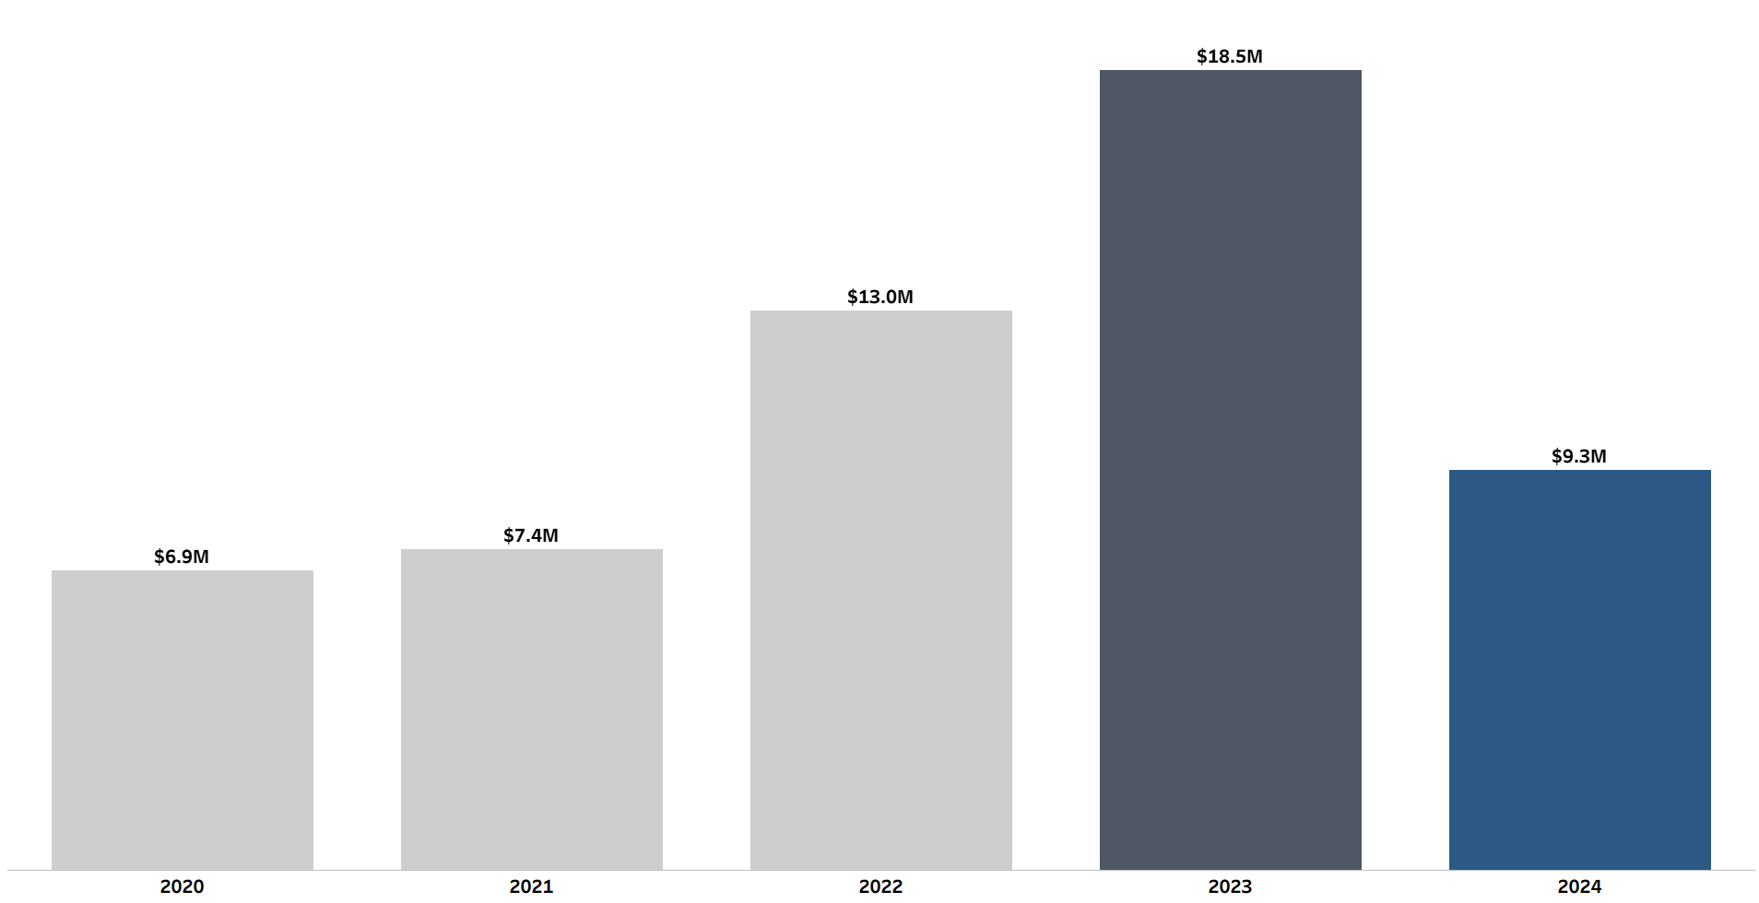
Post-Pandemic Sales Boom Peaks at $18.5M, Followed by 50% Correction in 2024.
▲ 43% YoY
Sales Growth
▼-50% YoY
Sales Declined
▲ 75% YoY
Sales Growth

Slide 6
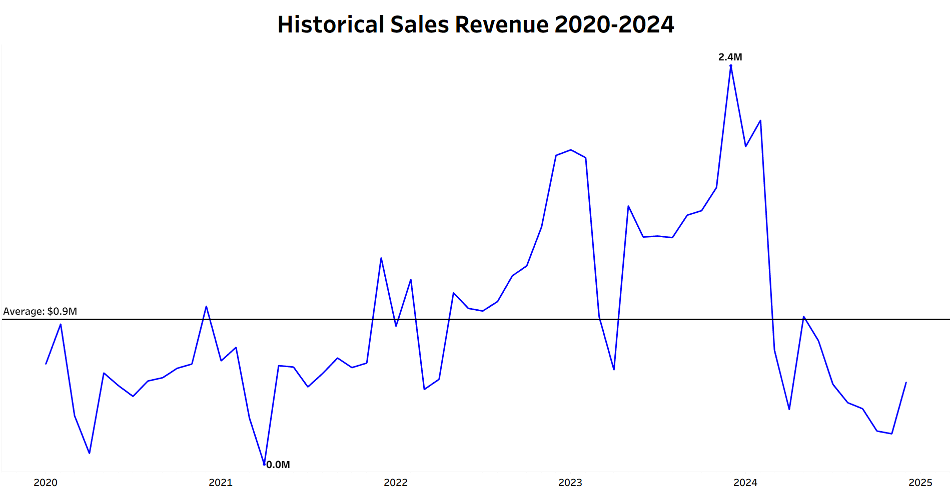
The Impact of Economic Slowdown and Demand Stabilization in 2024.
Monthly sales revenue in 2022 and 2023 consistently outperformed the average monthly sales benchmark of $0.9M – indicating shift in consumer behavior that lead to higher demand for electronic products.
The highest monthly sales was recorded in December 2023, reaching $2.4M, which is nearly 2.7 times above the average monthly sales of $0.9M.
Sales began to decline in early 2024 and continued to fall throughout each quarter – largely due to an economic slowdown and demand stabilized for electronic products.

Slide 7
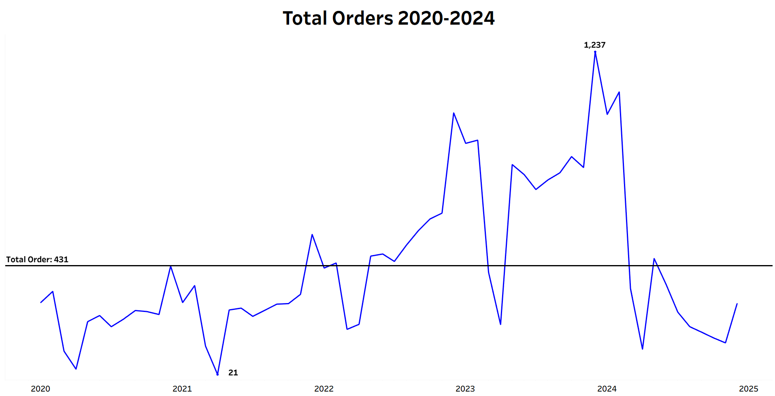
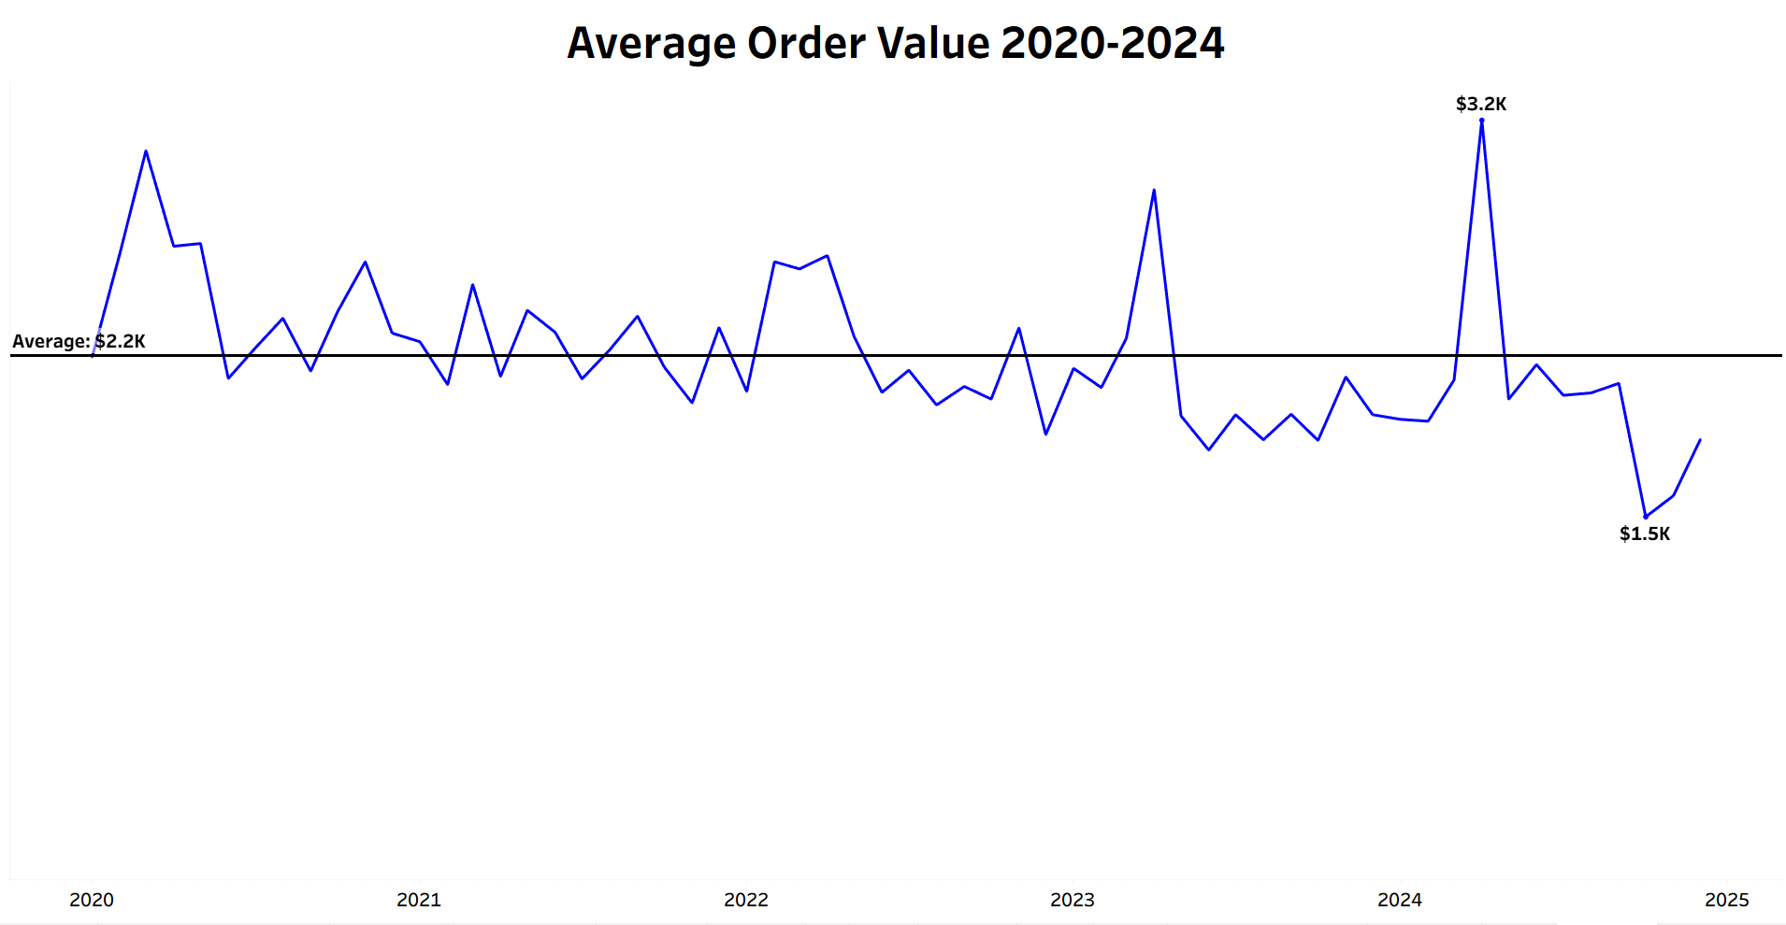
Order volume fluctuated while AOV stabilized, Indicating Total Orders are the Primary driver for Sales performances
Closely follows the sales trends.
Peak same as sales trends in Dec 2023 with total order of 1237.
Total Orders began to decline in 2024, reaching only 288 total orders by the end of 2024.
Remained consistent within the range of $1.5K to $3.2K from 2022 to 2024
The highest Average Order Value (AOV) was recorded in April 2024 at $3.2K, while the lowest occurred in October 2024 at $1.5K.

Slide 8
Product Category Demands

Slide 9
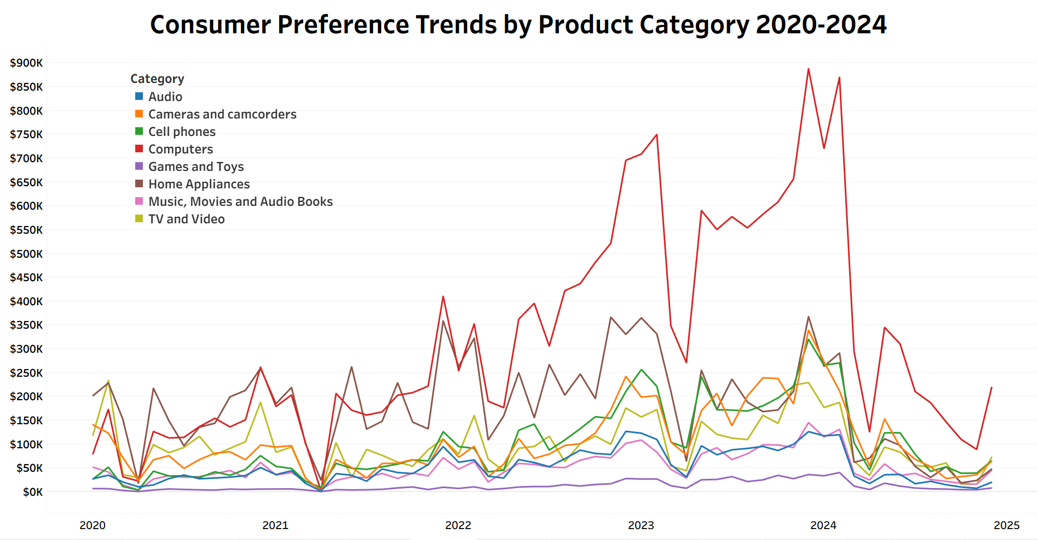
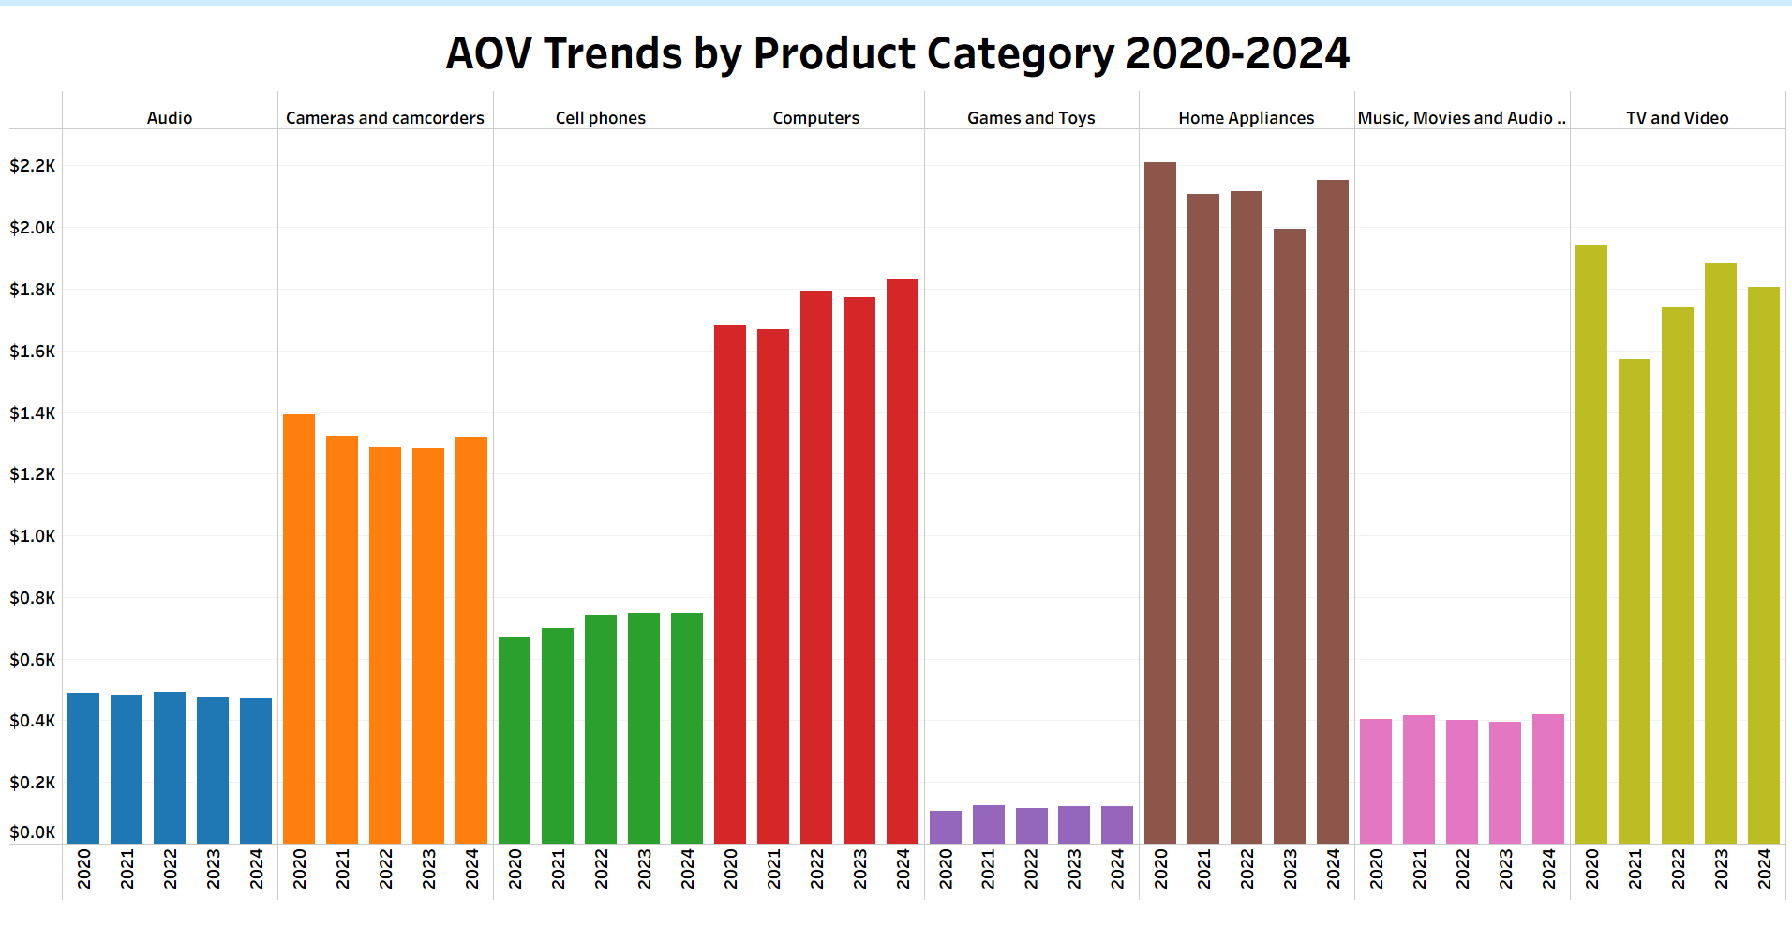
Computers products fueled the 2023 sales uptrend, but not sustained at high level.
Computers products consistently have been the top-performing category year 2021-2024.
  Sales share growth from 12%(2020) to 40%(2024).
  Overall total sales revenue at $19.5M across 2020-2024.
Despite being among the bottom three in total orders, the Home Appliances category generated approximately $10M in sales, making it the second-highest revenue contributor.
Cell Phones, Tv & Video and Camera & recorders are mid performers with strong growth until 2023, but show a decline in 2024.
All other product categories are considered laggards, with each contributing less than $1.5M per year.

Slide 10
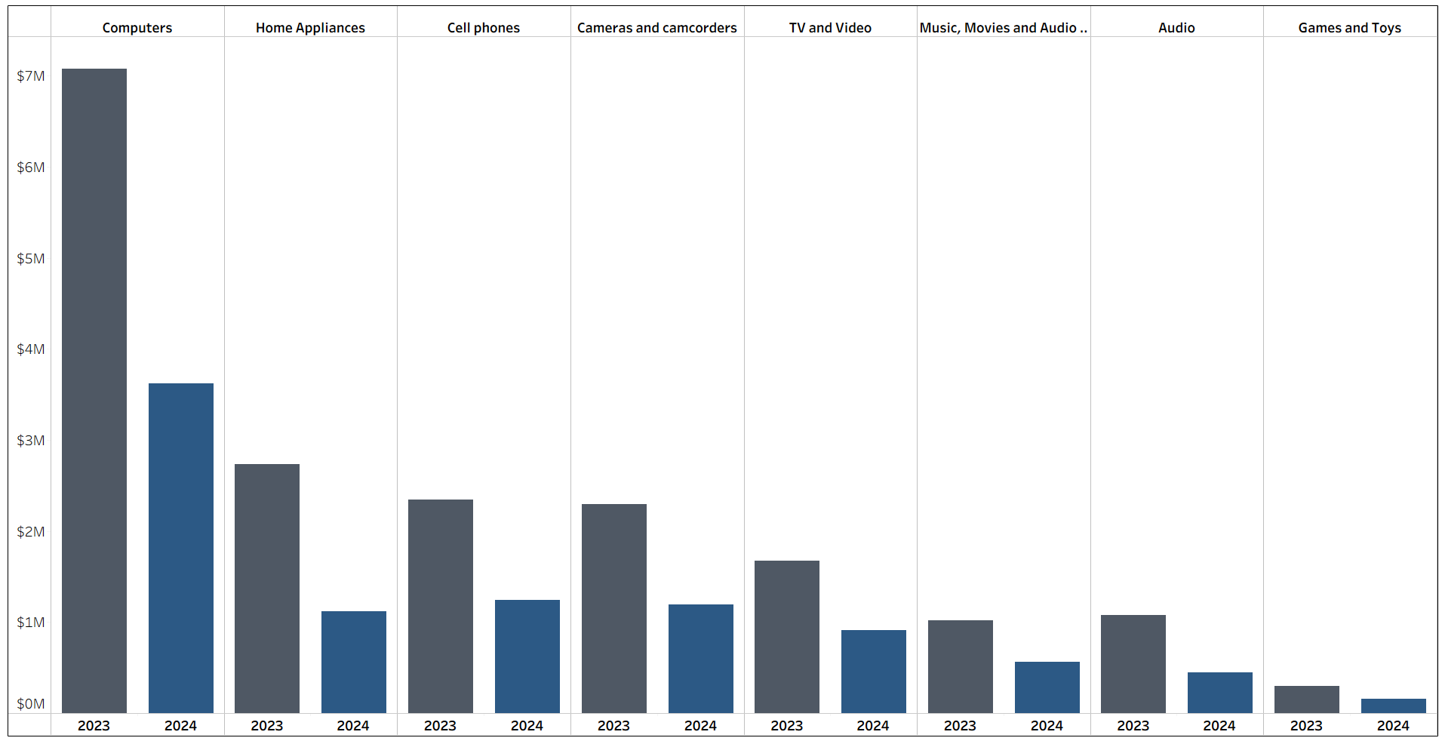
Universal Decline in Product Category Sales Signals Market Softening
Computers product experienced total revenue drops from $7.1M in 2023 to only $3.6M in 2024, about -49% sales drops.
Other categories also saw significant decreases in 2024, with total revenue falling between -45% to -59% YoY.
This suggest shift demands or customer retention
    Tech Nova need to re-strategize through marketing and promotions.

Slide 11
Country
Sales
Analysis

Slide 12
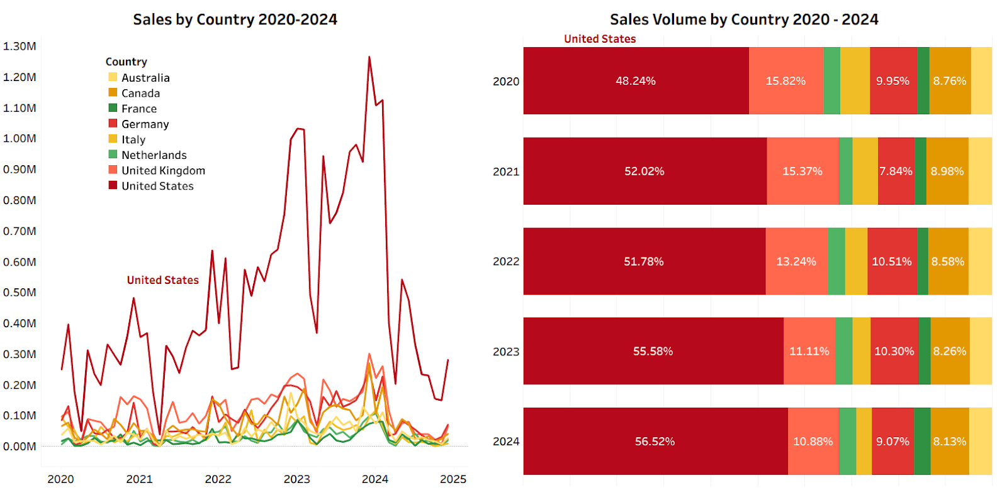
United States Contributes the largest share of sales revenue for Tech Nova.
Unites States generating nearly $30M in grand total sales from 2020 to 2024..
  Majority derived from computers product with total of $10M sales revenue.
  The highest monthly sales recorded in Dec 2023 at $1.27M.
The United Kingdom is the second-largest contributor, consistently achieving more than $1M in sales each year
Sales from other countries remain minimal, contributing less than $1.5M annually.

Slide 13
Recommendation

Slide 14
Recommendations
Sales
Focus on “volume surge” campaign to increase sales order volume.
  Offer tiered discount campaign like “Buy 2, free 1” or “50% off for second item”.
  Offer loyalty programs to rewarding repeated customer.
Win back the lost customer after the pandemic boom by offering new marketing promotion or extra benefits for returning customer.
Product
Focus on marketing the top product category.
enhance promotions for high AOV items such as Home Appliances and TV & Video.
Offer trade-in programs for high AOV products to boost it order volume.
Country
Strengthen the U.S. market share by consistently running targeted promotions in this region.
Conduct market research to identify the root causes of underperformance in other countries compared to the U.S

